Slide 1
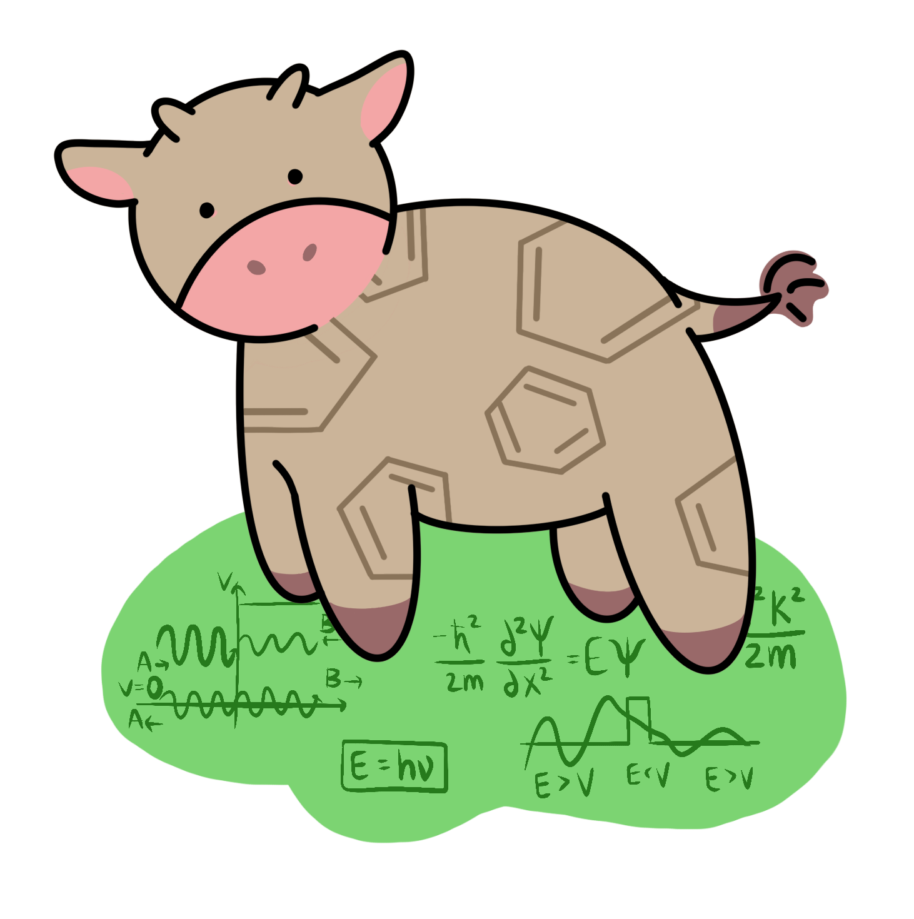
Interactive Plotting
COW Tutorial
March 29, 2024

Slide 2
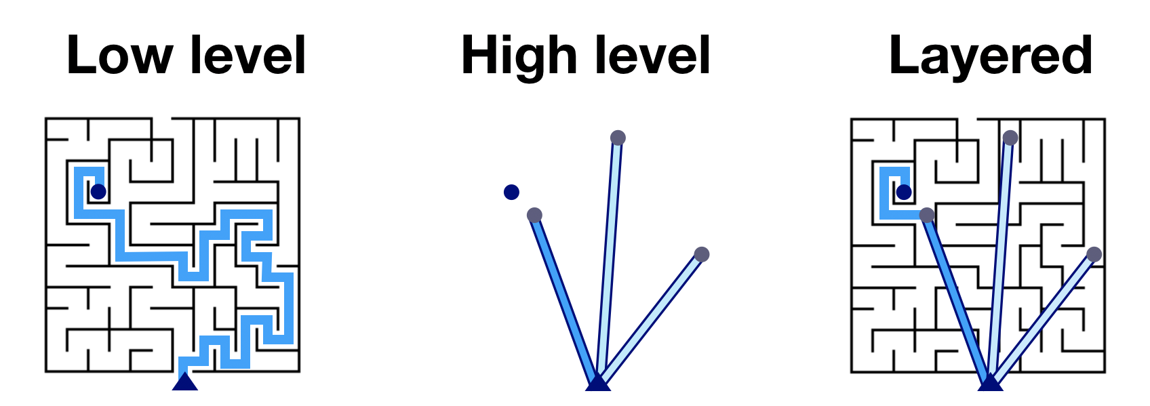
Intro to plotting packages
Highly configurable
Requires user oversight
Examples: Bokeh
Simple user interface
Difficult to make small changes
Examples: hvPlot, Panel
Combines functionality from low-level packages and accessibility from high-level packages
Examples: HoloViews, HoloViz

Slide 3
Anatomy of a HoloViews Plotting Function
Data
Function Type
dataframe
kdims=[x axis]
vdims=[y axis, any columns used for color/size/labels…]
plt = hv.Scatter(dataframe, kdims=[], vdims=[])
plt.opts(tools=[hover], title=title, marker=marker, color=color)
HoverTools
hover = HoverTool(tooltips=f""”
<div>
<div>@{image}{{safe}}
</div>
<div>
<span style="font-size: 17px</span>
</div>
</div>
""” )
Options
Customization of axes, labels, datapoint sizes/colors/transparency – very similar format to matplotlib

Slide 4
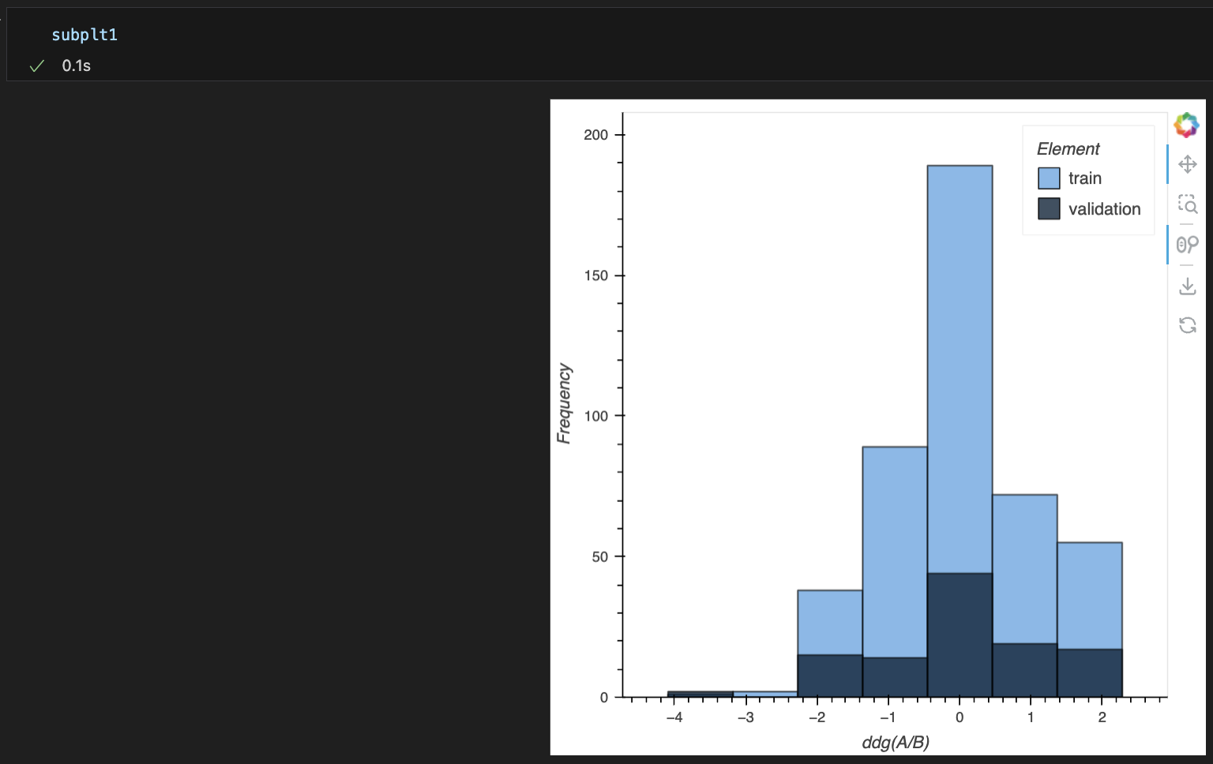
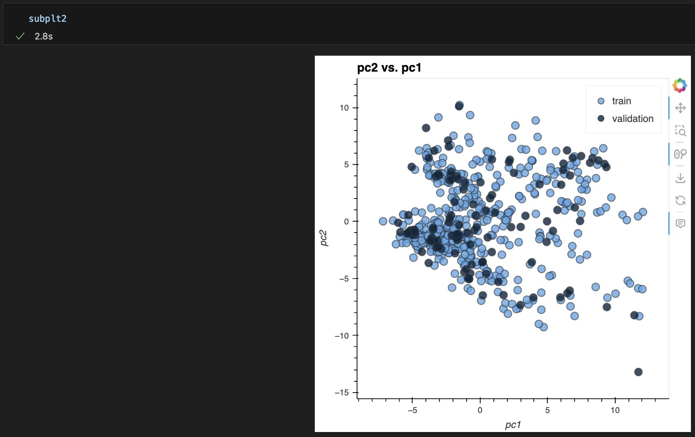
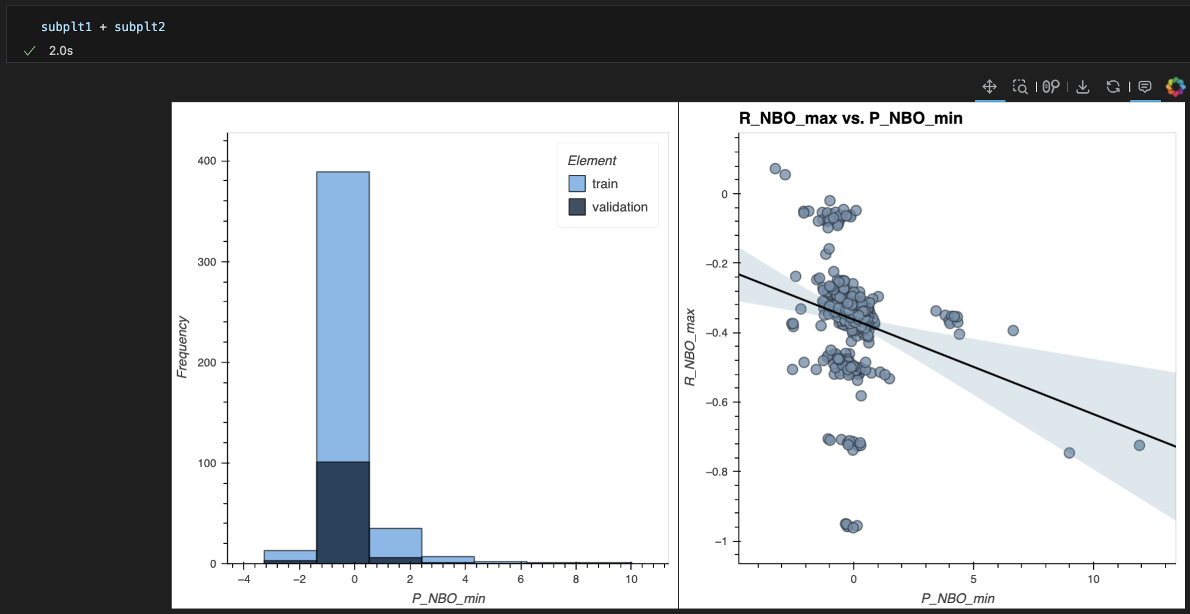
Adding subplots (+)

Slide 5
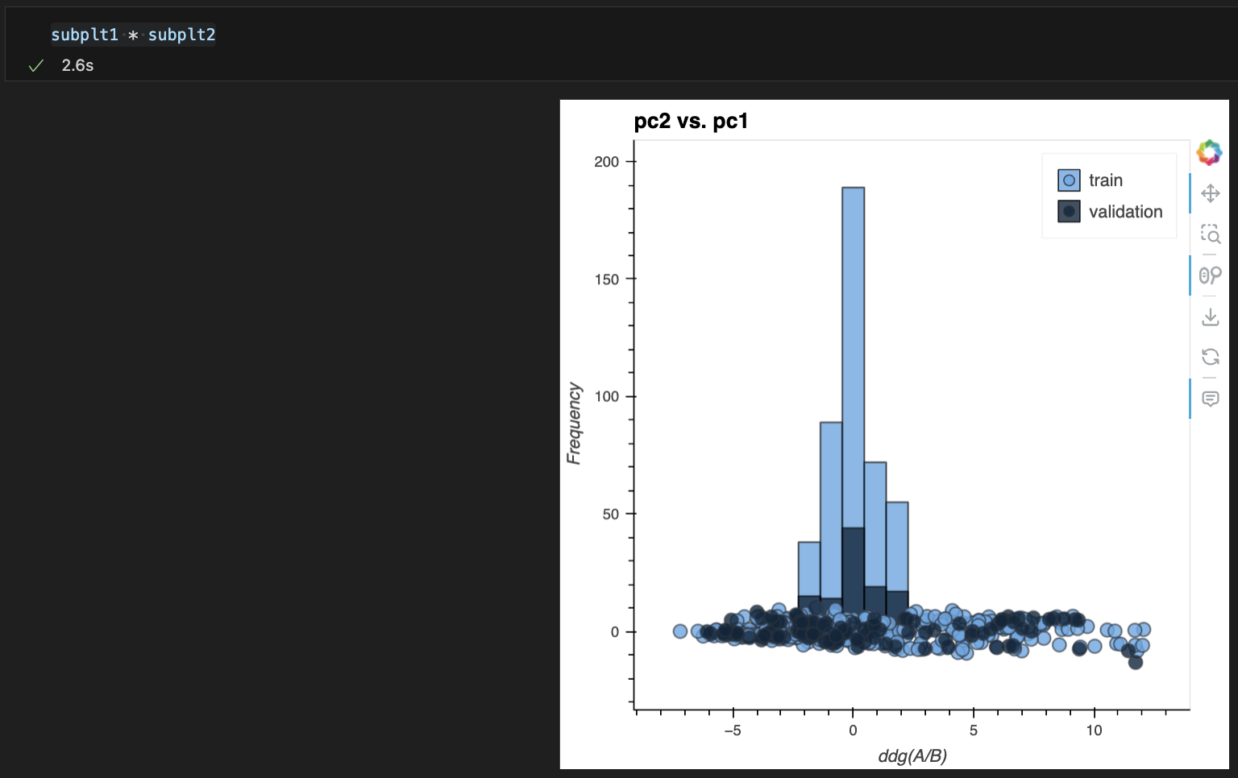
Layering plots/plot features (*)

Slide 6
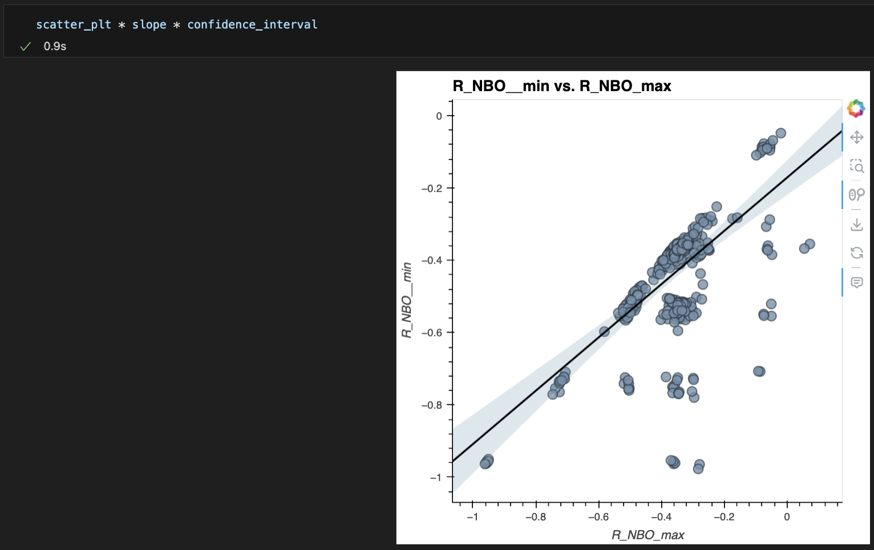
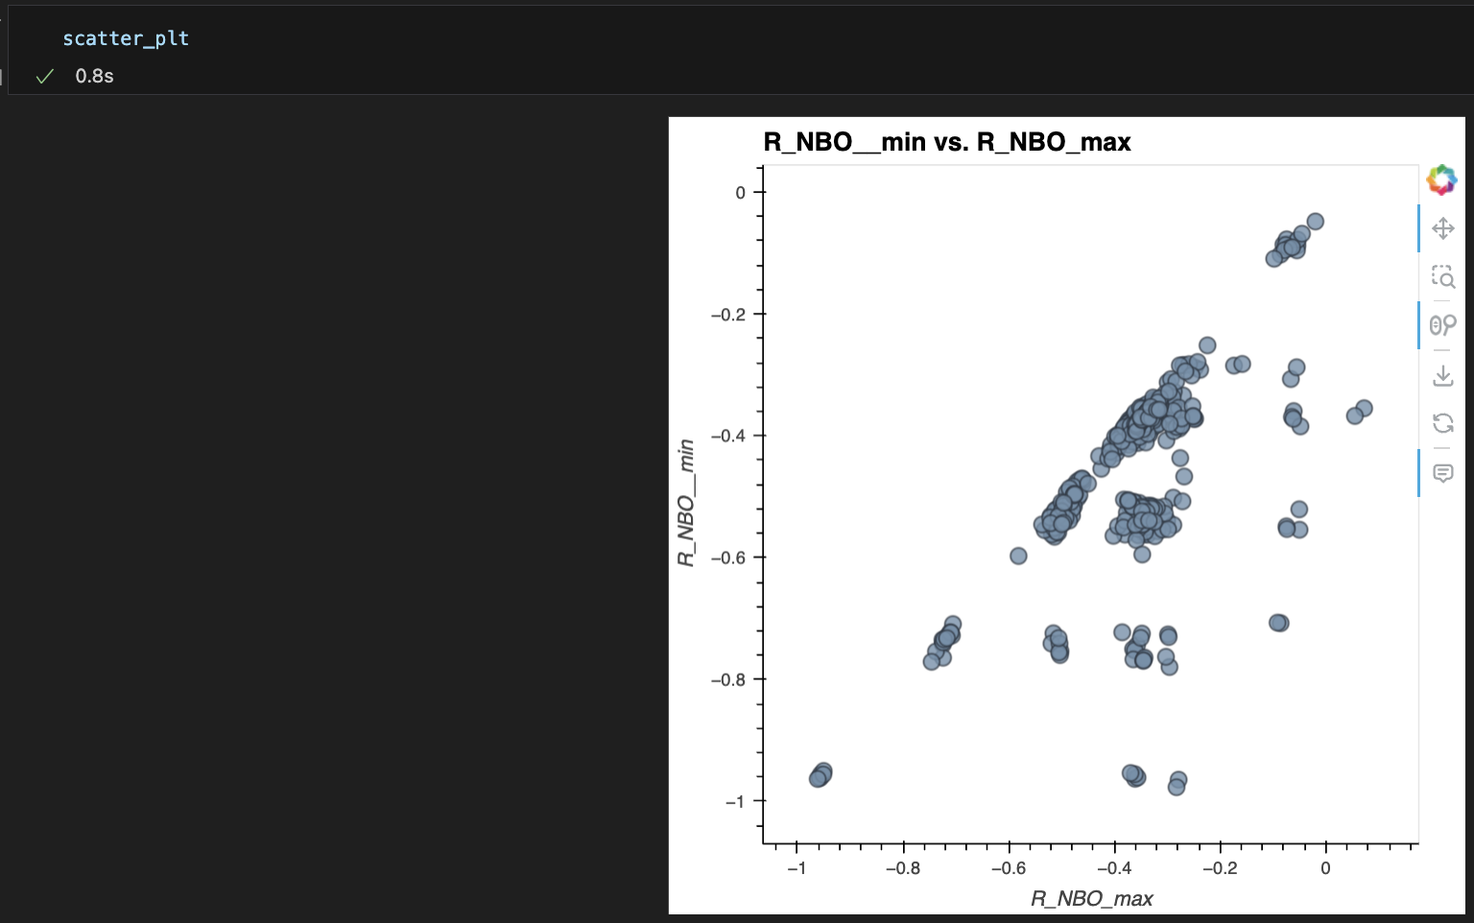
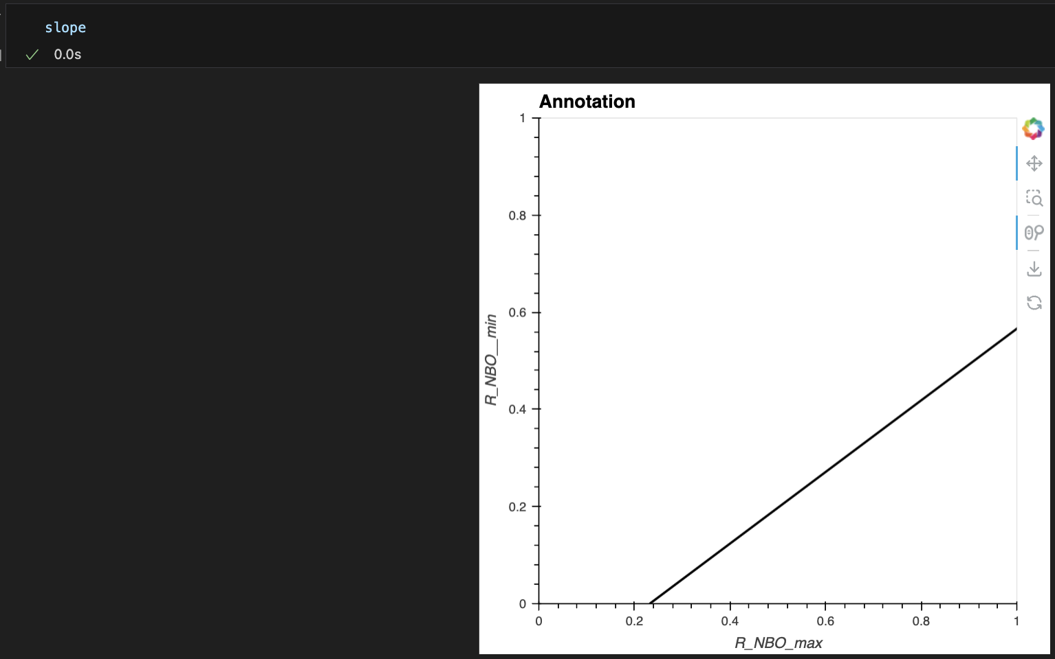
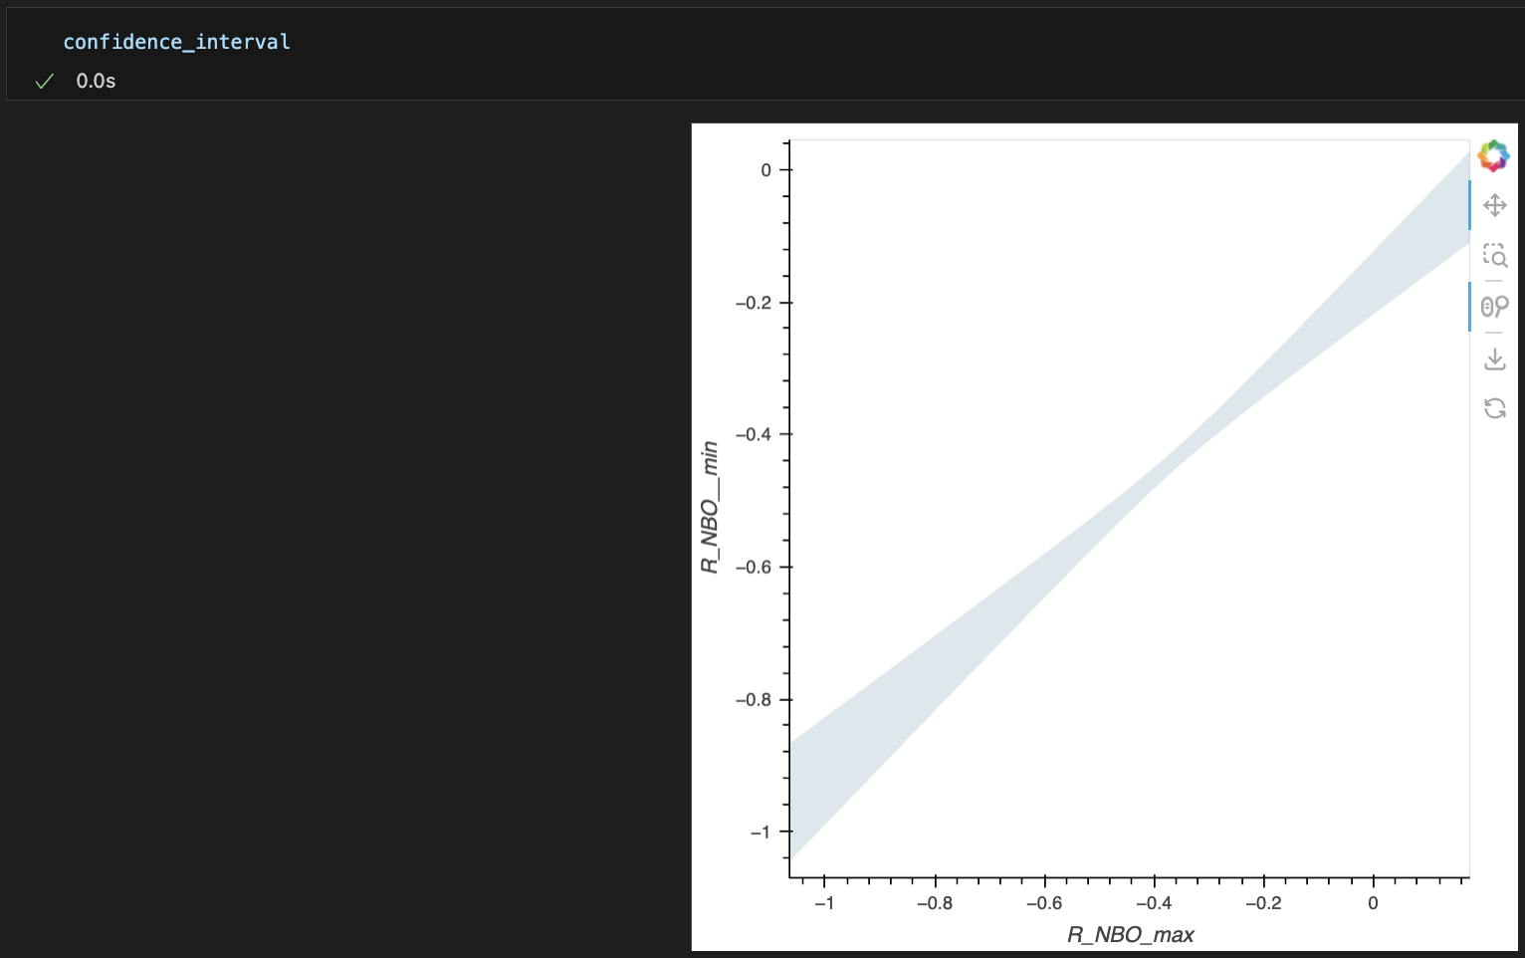
Layering plots/plot features (*)
Note: if combining multiple plots that contain hovertools, only bottom plot retains hovertool
The layers are added from
top-to-bottom, so the scatter_plt layer is in the back and confidence_interval is on top

Slide 7
Exporting and Sharing Plots
Exporting Plots
Screenshots = BAD!!
PNG = pixel file (most common in our group, restrictive)
SVG = vector file (can be scaled and modified easily)
HTML = markup file (can contain interactive information)
Sharing HTML Plots
File transfer
PowerPoint add-in (requires public web address for plots, clunky):
Install PowerPoint add in ‘Web Viewer’ (following slide)
Upload HTML file to a public GitHub repository
Open file – click ‘view Raw’
Change web address ‘githubusercontent’ to ‘githack’ – this renders your HTML file.
Copy web address and add to PowerPoint ‘Web Viewer’
HTML-based presentation (looking into this)
PowerPoint Web Viewer Tutorial

Slide 8
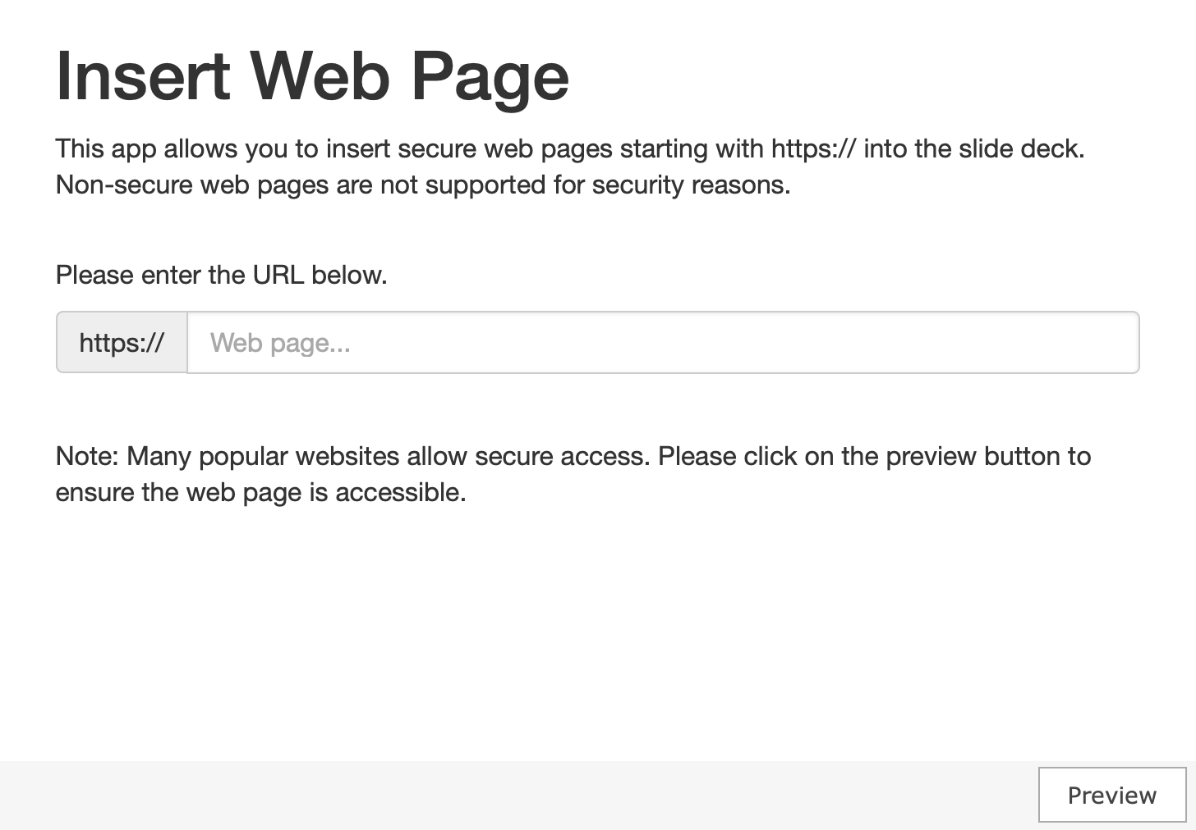
PowerPoint Add-In: Web Viewer

